Slide 1
An Unbiased Transformer Source Code Learning with Semantic Vulnerability Graph
Nafis Tanveer Islam, Gonzalo De La Torre Perra, Dylan Manuel, Elias Bou-Harb,
Peyman Najafirad*
Secure AI and Autonomy Lab
University of Texas at San Antonio
Accepted as a Conference paper at Euro S&P 2023
* Corresponding Author
Notes:
Good morning/afternoon/evening, distinguished attendees and respected members of the EuroS&P 2023. I am Nafis Tanveer Islam a fourth year PhD student in Computer Science from University of Texas at San Antonio.
On behalf of my co-authors Gonzalo De La Torre Perra, Dylan Manuel, Elias Bou-Harb and my supervisor and the corresponding author Peyman Najafirad, I am honored to present our paper entitled [An Unbiased Transformer Source Code Learning with Semantic Vulnerability Graph].
Our study focuses on the crucial topic of source code vulnerability detection, aiming to address the pressing challenges associated with identifying and mitigating vulnerabilities in software systems.
Our research delves into [vulnerability classification with description], aiming to offer valuable insights and innovative solutions that can significantly contribute to the advancements in [software security].

Slide 2

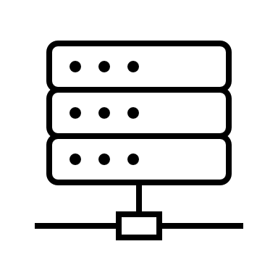


Predicting Vulnerabilities of a Program
Vulnerable
Is the code Vulnerable?
CWE-786
Out-of-bounds Write
Description
Developer
Notes:
Over the years, open-source software systems have become prey to threat actors. Even highly-adopted software has been crippled by unforeseeable attacks, leaving millions of devices exposed. Even as open-source communities act quickly to patch the breach, code vulnerability screening should be an integral part of agile software development from the beginning.
In our presentation, we will address the pressing security concerns that software developers often face during the development process. Typically, developers prioritize writing application features over considering security aspects. To bridge this gap and bring security to the forefront of developers' perspectives, we propose a novel approach by employing code analysis to Detect and Classify vulnerabilities in the raw code.
Furthermore, we acknowledge that developers may not possess extensive expertise in vulnerability classifications. Hence, we offer curated descriptions that empower developers to effectively address and resolve identified vulnerabilities with ease.

Slide 3
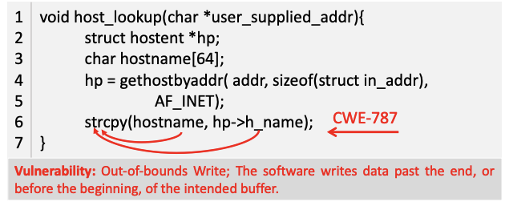
A Motivating Example: Semantic Vulnerabilities on Code

Slide 4
List of Contributions:
We propose a unique set of edges dubbed Poacher Flow edges, such that each of these edges is associated with a set of vulnerabilities.
We propose a joint interpolated multitask unbiased vulnerability classifier comprising a transformer ”RoBERTa” and graph convolution neural network (GCN) with Poacher Flow (PF) edges called RoBERTa-PFGCN, trained using the Focal Loss function to address data imbalance issues with VulF Dataset.
We further investigated the effectiveness of our vulnerability classifier by utilizing our proposed dataset VulF and four real-world, large-scale C/C++ vulnerability datasets.

Slide 5
Research Questions
We conducted our experiment on three large corpora of real-world programs collected from publicly available open- source resources. Our Experiments were designed with the purpose of providing an answer the following three Research Questions (RQs):
RQ1: Based on our proposed SVG representation, can the classifier learn to identify and provide CWE Numbers of vulnerabilities in real-world source code?
RQ2: Can our classifier learn vulnerability in a biased setting?
RQ3: Is our classifier generalized enough to detect vulnerabilities in N-day and zero-day program samples?

Slide 6
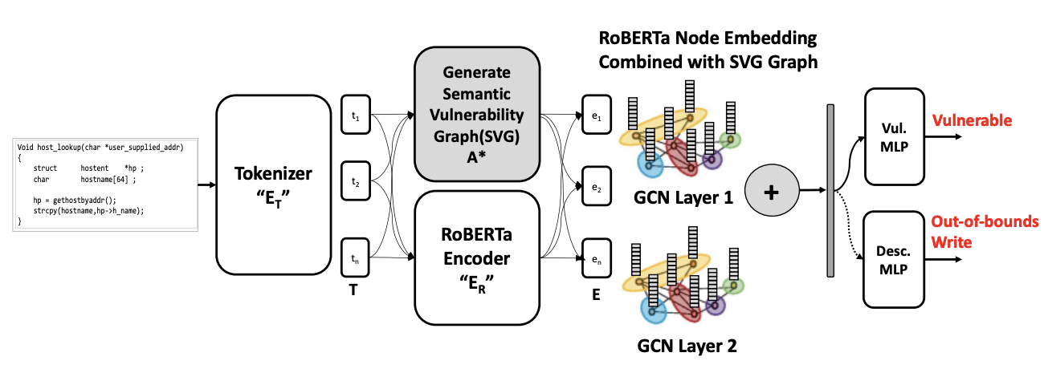
How Does Vulnerability Detection and Classification Work?
Residual Graph Convolution Network
Graph Representation of Programs

Slide 7
Semantic Vulnerability Graph (SVG)
Our Graph Representation of Program has 4 components:
Data Flow: Data flow edges are the connection between two variables dependent on each other during value assignment or modification or other usage
Control Flow: Shows the order of statements being executed of the program
Sequential Flow: Demonstrates the syntactic relationship of the tokens of a program
Poacher Flow: We defined Poacher Flow edges to bridge the gap between dynamic and static analysis of source code to identify potential corner cases, and external checkpoints or external environment context. Poacher flow has 3 components:
Data Processing
Access Control
Resource Management

Slide 8
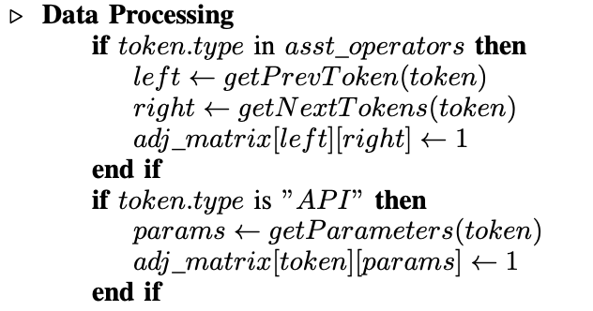
Poacher Flow Edges: Data Processing

Slide 9
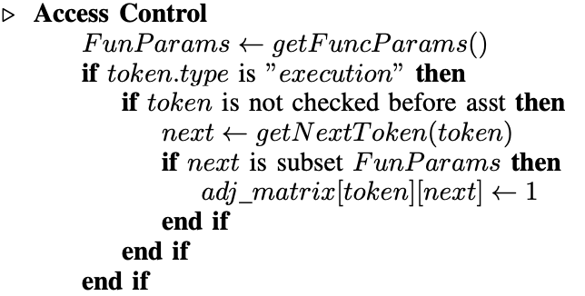
Poacher Flow Edge: Access Control

Slide 10
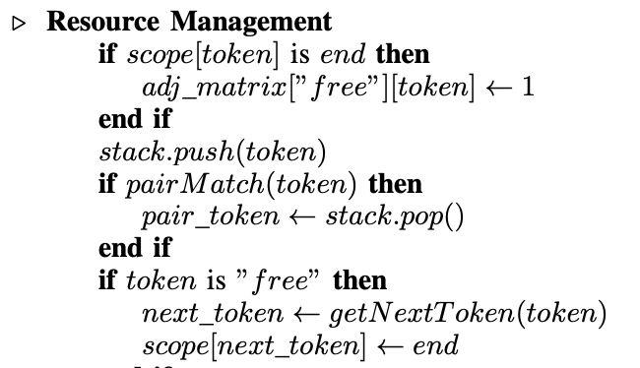
Poacher Flow Edges: Resource Management

Slide 11
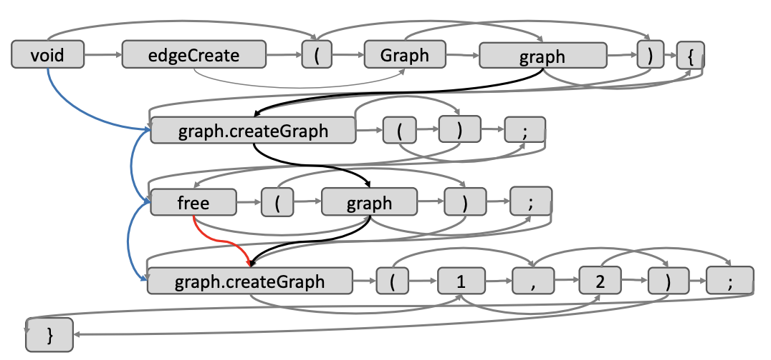
Semantic Vulnerability Graph: An Example
Control Flow
Data Flow
Sequential Flow
Poacher Flow

Slide 12
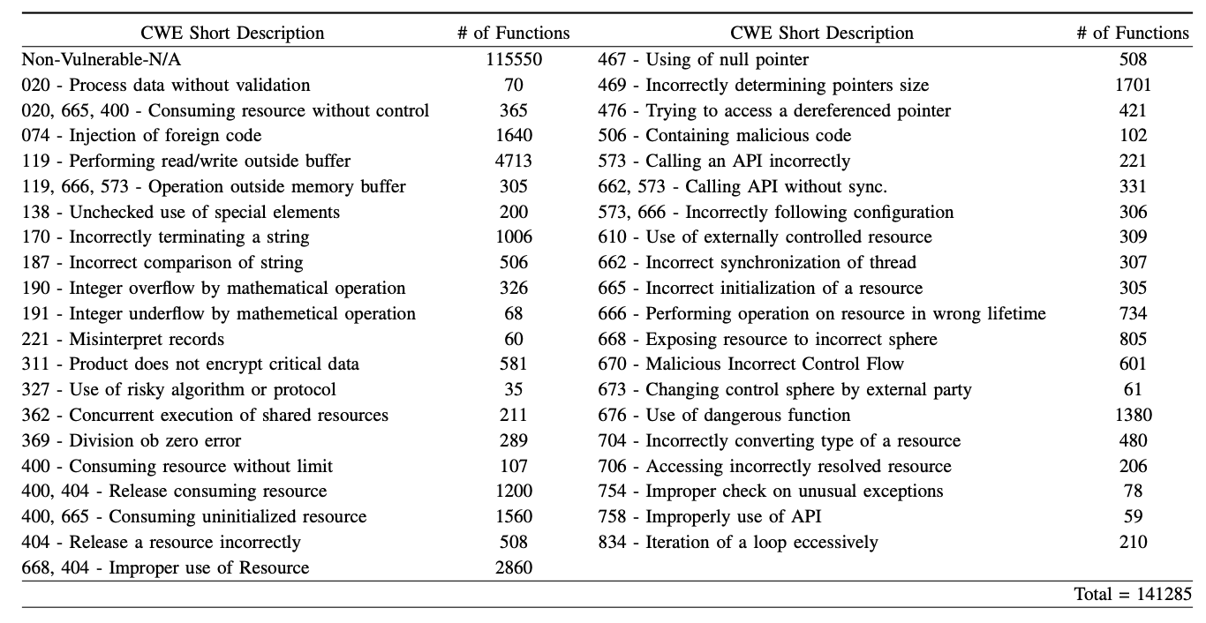
Datasets: Vulnerability Finder (VulF)
VulF: We created VulF, a large-scale dataset comprised of data from multiple publicly available sources including NVD, GitHub rpsitories.
We also used 4 other datasets
ReVEAL
FFMpeg+Qemu
D2A
MVD

Slide 13
Descriptions of CWE-119: A sample
CWE-119 is also known as “Improper Restriction of Operations within the Bounds of a Memory Buffer.” This weakness occurs when memory locations that aren’t compatible with the given memory buffer are addressed by the application. This can result in the disclosure of important information, crashes, and arbitrary code execution. Mitigations include using languages immune to buffer overflows (such as Java), validate the size of buffers, and abandon the use of unbounded copy functions.
// Vulnerable code example for CWE-119
void print_input(char *input)
{ ... printf(input); ... }
In this example, the print_input function takes an input string and prints it using printf. However, the function does not properly validate or sanitize the input string before passing it to printf. This can allow an attacker to inject formatting characters or other special characters, leading to a format string vulnerability.
// Vulnerable code example for CWE-119 is fixed below
void print_input(char *input)
{ printf("%s", input); }
To mitigate this vulnerability, it's important to ensure that the input string is properly sanitized before using it in a format string. One way to do this is to use the %s format specifier to ensure that the input string is treated as a plain string and not a format string.

Slide 14
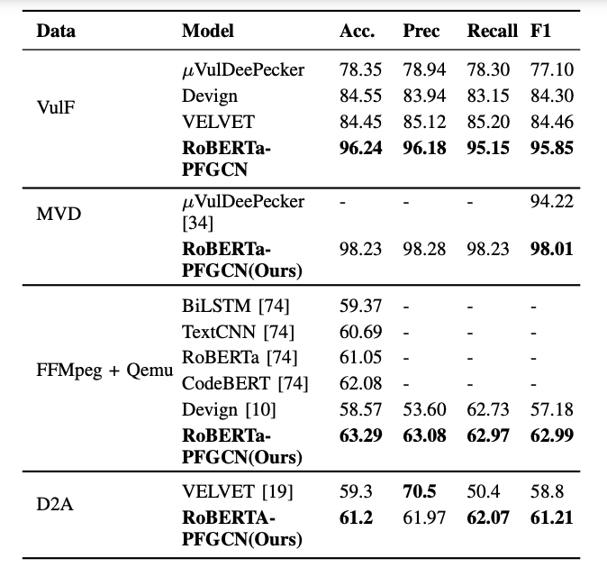
Answering RQ1: Based on our proposed SVG representation, can the classifier learn to identify and provide CWE Numbers of vulnerabilities in real-world source code?
Comparison of our proposed RoBERTa-PFGCN
vulnerability detection model against top recent models, including muVulDeePecker, BiLSTM, TextCNN, RoBERTA, CodeBERT, Devign, and VELVET, with a focus on their respective datasets.

Slide 15
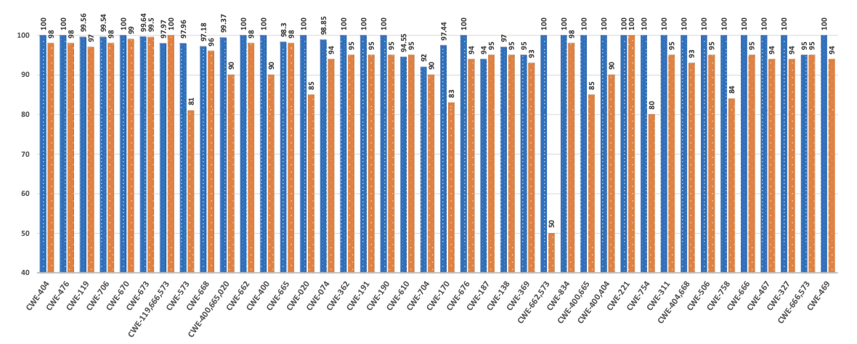
Contd’
CWE class-by-class F1 score comparison on our proposed Model (RoBERTa-PFGCN), vs. muVulDeepecker on MVD dataset provided by muVulDeePecker including 40 CWE classes. The blue bar corresponds to RoBERTa-PFGCN, while the orange bar represents mu$VulDeepecker.

Slide 16
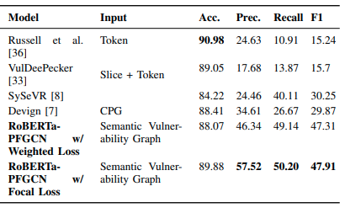
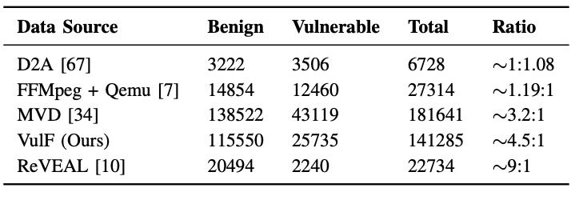
Answering RQ2: Can our classifier learn vulnerability in a biased setting?
To answer RQ2, we only used the ReVEAL dataset since it is highly imbalanced. instead of using Cross Entropy Loss, we use Focal Loss, a variant of Cross Entropy Loss to handle the data imbalance factor. Focal Loss has 2 parameters, α to handle the data imbalance and 𝛾 to focus more on incorrectly predicted source code.

Slide 17
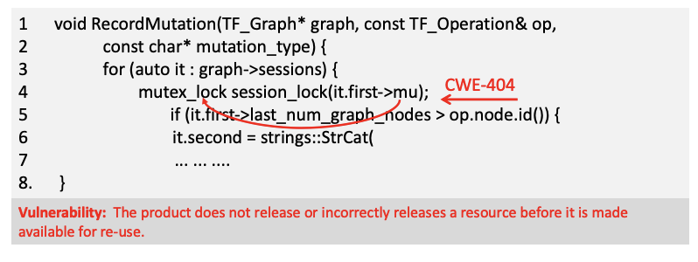
Answering RQ3: Is our classifier generalized enough to detect vulnerabilities in N-day and zero-day program samples?
We collected 273 N-day vulnerable code sample and out of them our model was able to detect 255 and 4 zero-day vulnerabilities. The following figures shows a case-by-case analysis how our PF edges aids in detecting vulnerability.

Slide 18
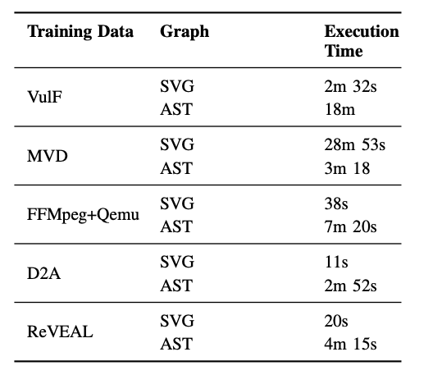
Time and Memory Analysis
We also did a time and memory analysis to show the performance of our model. We used two different types of input. One of them is AST, which is commonly used in source code analysis. We see that our SVG takes significantly less time to generate compared to an AST. Moreover, when using AST, the stack size had to be increased to 3000 since it a lot of memory during recursive analysis of the tree.

Slide 19
Code and Dataset
Our code and and Datasets are available in the following URL: SemVulDet

Slide 20
Thank You!

